Slide 1
Object Oriented Design

Slide 2
Object Oriented Design
Object oriented design is the result of focusing attention not on the function performed by the program, but instead on the data that are to do manipulated by the program
Begins with an examination of the real world “things” that are part of the problem to be solved. These things (which we will call objects) are characterized individually in terms of their attributes and behavior.

Slide 3
Object Oriented Design- Features
Object Oriented Design is not dependent on any specific implementation language.
Problems are modeled using objects.
Objects have:
Software Design
Basic Concepts
Behavior (they do things)
State (which changes when they do things)

Slide 4
Object Oriented Design- Terminology
The various terms related to object design are:
Objects
The word Object is an entity able to save a state (information) and which offers a number of operations (behavior. An object is characterized by number of operations and a state which remembers the effect of these operations.
2. Messages
Objects communicate by message passing.
Messages consist of: the identity of the target object,
the name of the requested operation and
any other operation needed to perform the function.
Message are often implemented as procedure or function calls.

Slide 5
3. Abstraction
In object oriented design, complexity is managed using abstraction. Abstraction is the elimination of the irrelevant and the amplification of the essentials.
Class
In any system, there shall be number of objects. Some of the objects may have common characteristics and we can group the objects according to these characteristics. This type of grouping is known as a class. Hence, a class is a set of objects that share a common structure and a common behavior.
For example: We may define a class “car”and each object that represent a car becomes an instance of this class. In this class “car”, Indica, Santro, Maruti, Indigo are instances of this class
Classes act as a blueprint for objects

Slide 6
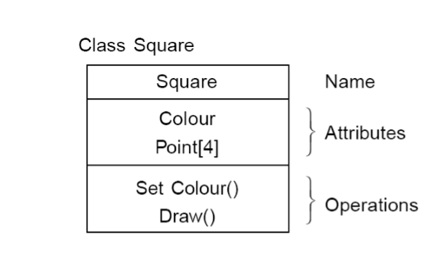
5. Attributes
An attributes is a data value held by the objects in a class. The square class has two attributes: a colour and array of points. Each attributes has a value for each object instance.

Slide 7
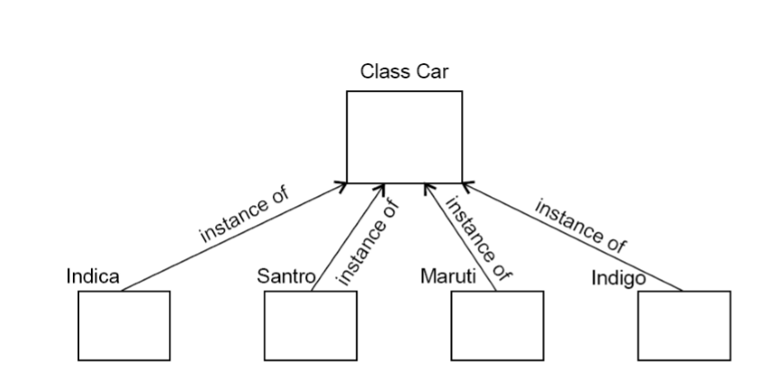
Example

Slide 8
6. Operations
An operation is a function or transformation that may be applied to or by objects in a class.
In the square class, we have two operations: set colour() and draw(). All objects in a class share the same operations. An object knows its class, and hence the right implementation of the operation.

Slide 9
Now, comparing we can see that there is some difference between triangle and squares classes.
For example, at a high level of abstraction, we might want to think of a picture as made up of shapes and to draw the picture, we draw each shape in turn. We want to eliminate the irrelevant details: we do not care that one shape is a square and the other is a triangle as long as both can draw themselves. To do this, we consider the important parts out of these classes in to a new class called Shape.

Slide 10
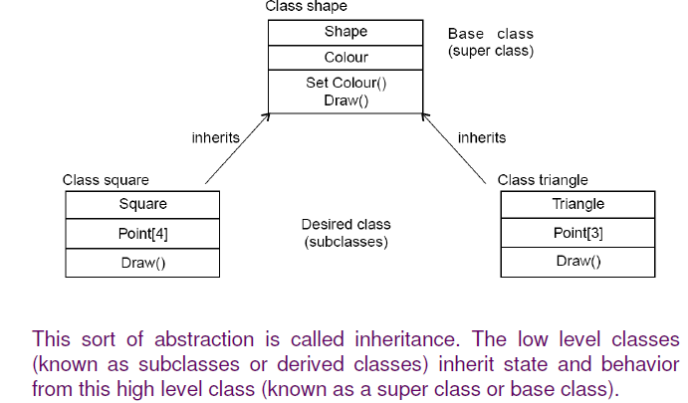

Slide 11
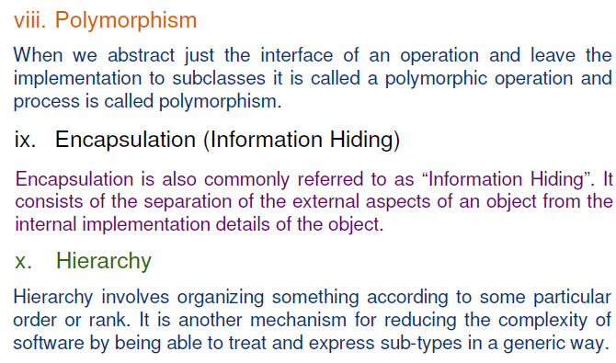

Slide 12
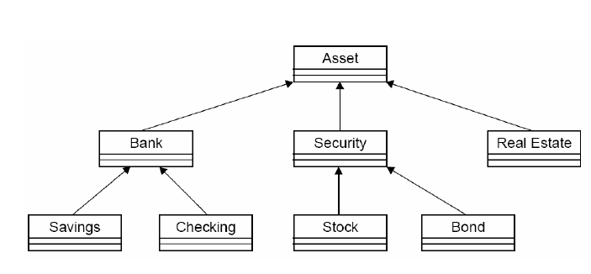

Slide 13
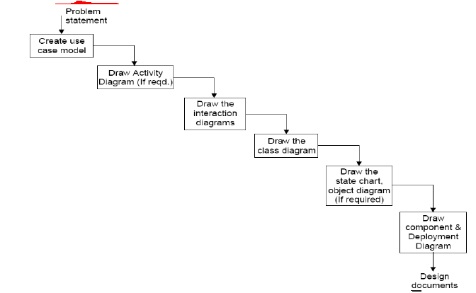
Steps to analyze object oriented design

Slide 14
Multiple-Choice Questions
1) If the objects focus on the problem domain, then we are concerned with ______.
a. Object Oriented Analysis
b. Object Oriented Design
c. Object Oriented Analysis and Design
d. None of the above
2) Aggregation represents ______ .
a. is_a relationship
b. part_of relationship
c. composed_of relationship
d. none of above

Slide 15
Multiple-Choice Questions
3) The feature of the object oriented paradigm which helps code reuse is _______ . a. Object
b. Class
c. Inheritance
d. Aggregation.
4) Coupling and cohesion can be represented using a _______ .
a. cause-effect graph
b. dependence matrix
c. Structure chart
d. SRS
5) Modular design unintentionally follows the rules of 'divide and conquer' problem solving strategy. a. Yes
b. No

Slide 16
solution
1. a
2. c
3. c
4. b
5. a

